Slide 1
A TRIP TO MARS
PRESENTED BY: TEAM SPAM BYTES
SAHIL RAJA(1705444)
SARANYA JENA(1705452)
ABHIPSA NAYAK(1705384)

Slide 2
CONTENTS:
Introduction
Abstract
Objective
Technology Stack
Learning Outcomes
Screenshots of the Application
Note
References

Slide 3
Introduction:
It's been almost 50 years since humans have stepped foot on “unearthly ground”- that is, the Moon. The moon is near and the mission takes about 15-20 days. Various Problems were faced by the space explorers, which took years to resolve.
Our next destination in the human exploration of space will be Mars. Although we don’t yet have any definite plans for getting there, many people are busy working on the many problems that will have to be solved to accomplish this very difficult goal. As compared to moon, obviously the problems will be more difficult and much more complex.

Slide 4
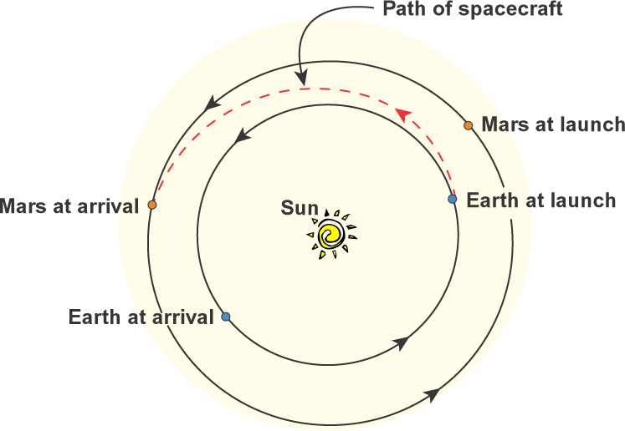
The main challenge is that Mars is much farther away than the moon. Mars is the fourth planet from the Sun, and Earth is the third planet from the Sun.
It takes Earth about 365 days to make one orbit around the Sun (one Earth year). It takes Mars 687 Earth days to make its journey around the Sun. So to get to Mars, we blast off from Earth going in the same direction as Earth and Mars are both traveling around the Sun, and by adding a little speed using the spacecraft’s engines, we eventually match up with Mars’orbit and catch up to Mars itself. If we don’t care about gas mileage, we can really step on it and get there in six months! A more fuel-efficient trip takes about 11 months.

Slide 5
So, after a six-month journey, you land on Mars and have to stay at least 19 months, until Mars and Earth approach their closest positions again before you take off for the six-month journey home. You will be gone a total of about 2-1/2 years!
A Trip to an Alien Planet for 2-1/2 years!!!
Packing is very important in such case. Not just Packing, Efficient Packing. Do you know how to do it??

Slide 6
Abstract:
Trip to Mars is a native game application that helps the players in strategically planning for a space expedition in a fun way.
Target Audience for the application are kids and teens.
Kids theses days are very interested in the subject of space exploration and the unknown. But, due to the monotonic and tiring nature of the research, they eventually get bored and dump the Idea.
The Trip to Mars is a kind of app that helps the players in learning a lot about the space and how these space missions operate through helping them imagine being a space explorer on a mission to Mars.

Slide 7
Objective:
The player is on a space mission to Mars. And they have been provided with a box 1 meter wide by 1 meter high by 1 meter deep—in other words, having a volume of 1 cubic meter (1 m³)(One meter is about 39-1/2 inches) within which they have to pack all the items that they want to take for the mission.
The Players are need to choose the items, from the given set of options. All the choosen items must fit into a box.
Each item would have their own volume which would be added to the to the box accordingly.
The objective of the game is Packing the given box most efficiently and thereby gainning most points!
Result:
Most Efficient packing gains most points. At the end of the game, the app explains the relevance of each choosen item and describing it's efficiency. The app also splashes some trivia at the end.

Slide 8
Technology Stack:
Flutter SDK
Dart
Android Studio

Slide 9
Learning Outcomes:
Players, through the game are introduced to the historical motivation for space exploration.
Identifying potential reasons why people want to travel to space.
Describing how different types of engineers each contribute to space travel.
Learning more about MARS! Research activities about the Red Planet.
Learning more about the NASA and International Space Station
They are introduced to new and futuristic ideas that space engineers are currently working on to propel space research far into the future!

Slide 10
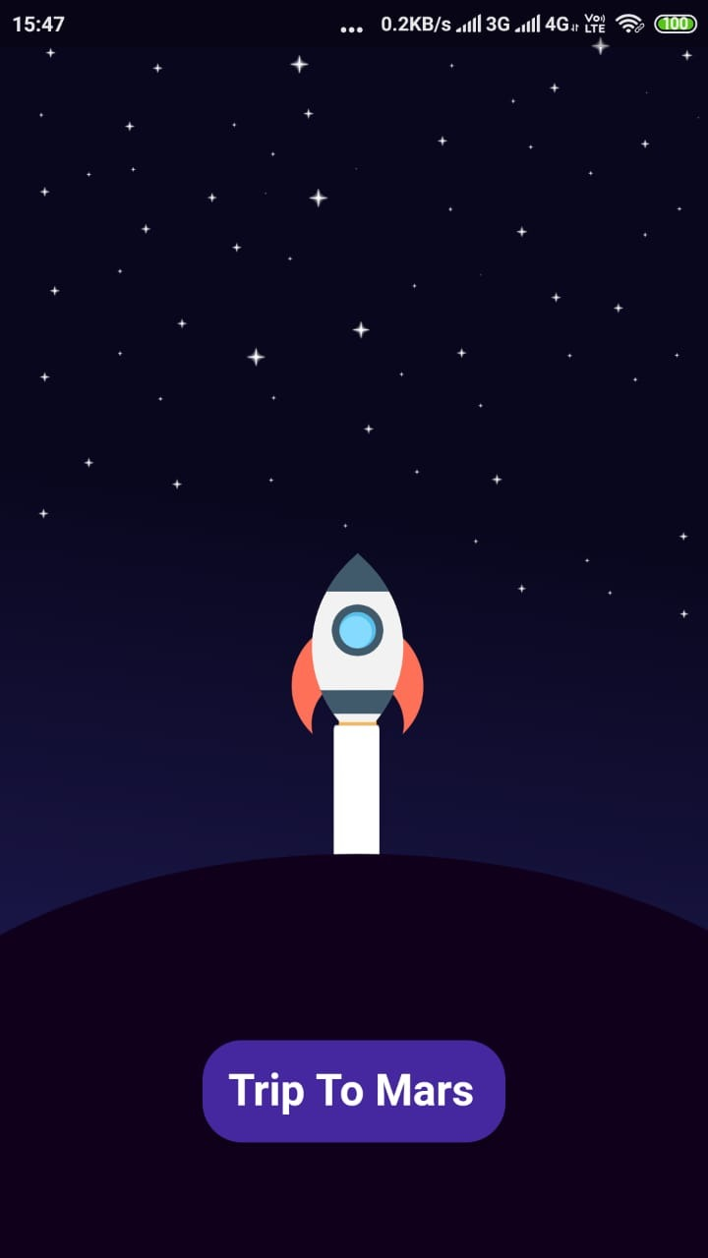
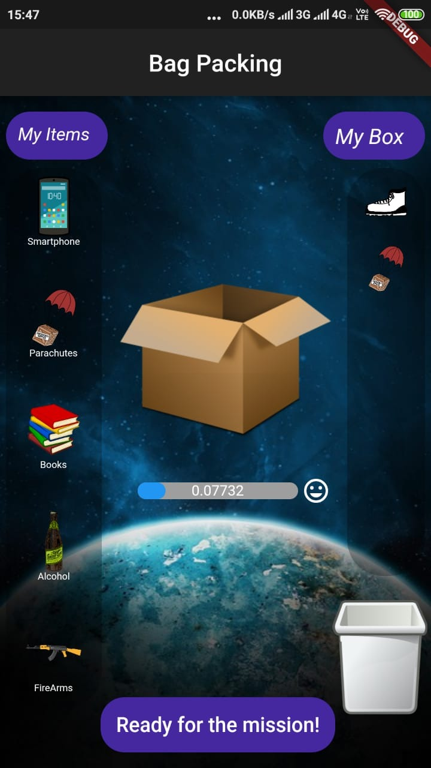
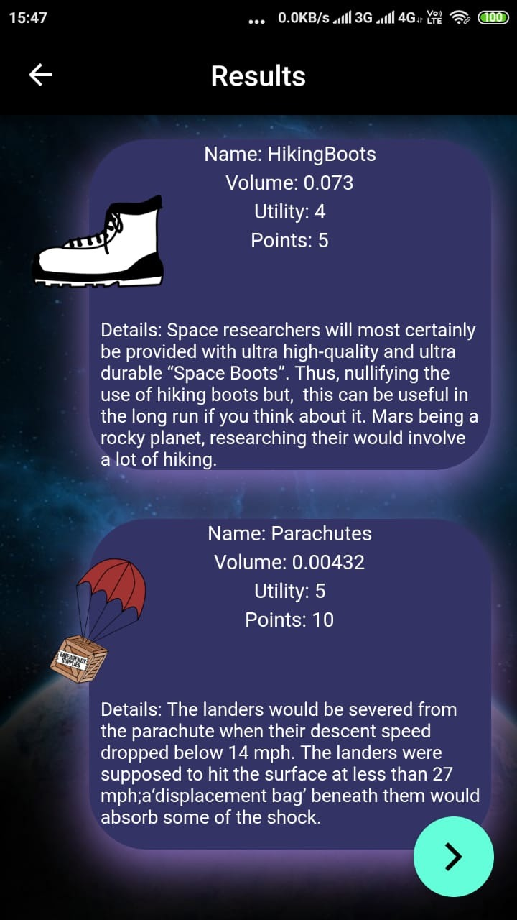
Screenshots of the Application:

Slide 11
Note:
The activity performed in the app is a popular classroom activity recommended by NASA to schools for motivating young minds towards space research.
Converting this fun activity to an interactive app gives the consumers the liberty to learn at their own pace, at any time , anywhere.

Slide 12
References:
https://spaceplace.nasa.gov/classroom-activities/en/
https://www.nasa.gov/feature/can-plants-grow-with-mars-soil/
https://www.space.com/24115-mock-mars-mission-packing.html
https://prezi.com/ri1xa5ln0suv/10-things-to-bring-to-mars/

Slide 13
Thank you

